Slide 1

Year 8: Probability Robot Activity
Dr J Frost (jfrost@tiffin.kingston.sch.uk)
Associated resources: Laminated cards. Answer input sheet.
Last modified: 30th January 2014

Slide 2
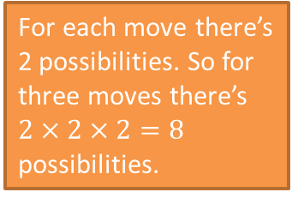
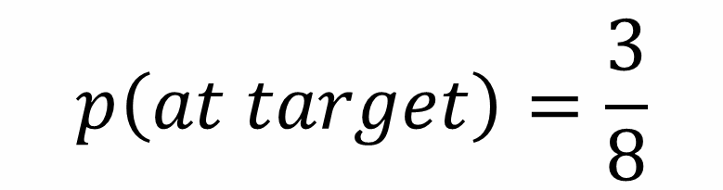
End Point
Start Point
For each move there’s 2 possibilities. So for three moves there’s $2×2×2=8$ possibilities.
He could have gone RRU, RUR or URR.
$$p\left(at target\right)=\frac{3}{8}$$
?
A robot can only move up or right.
What’s the probability he’s at the end point after exactly 3 moves.
?

Slide 3
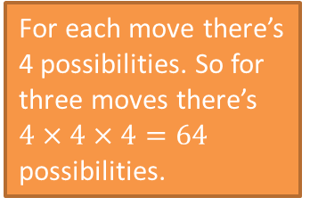
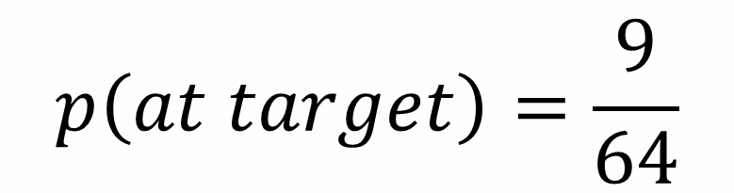
End Point
Start Point
For each move there’s 4 possibilities. So for three moves there’s $4×4×4=64$ possibilities.
He could have gone DUU, LRU, RLU, LUR, RUL, ULR, URL, UUD, UDU.
$$p\left(at target\right)=\frac{9}{64}$$
?
A robot can now move in any direction.
What’s the probability he’s at the end point after exactly 3 moves.
?

Slide 4
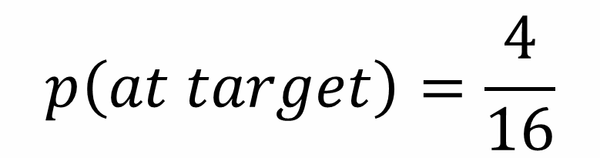
Problem 1
Num moves: 2
Start Point
End Point
$$p\left(at target\right)=\frac{4}{16}$$
?
?

Slide 5

Problem 2
Num moves: 4
End Point
Start Point
$$p\left(at target\right)=\frac{6}{16}$$
?
?

Slide 6
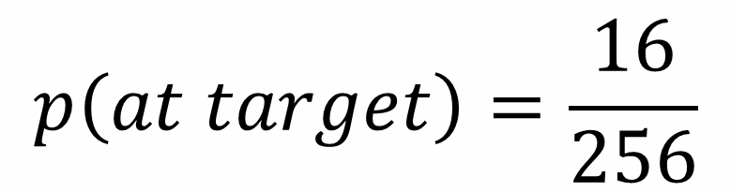
Problem 3
Num moves: 4
Start Point
End Point
$$p\left(at target\right)=\frac{16}{256}$$
?
?

Slide 7
Problem 4
Num moves: 4
Start Point
End Point
$$p\left(at target\right)=\frac{4}{16}$$
?
?

Slide 8
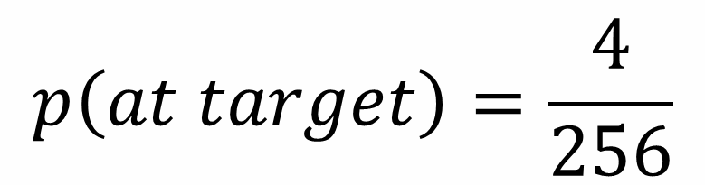
Problem 5
Num moves: 4
End Point
Start Point
$$p\left(at target\right)=\frac{4}{256}$$
?
?

Slide 9
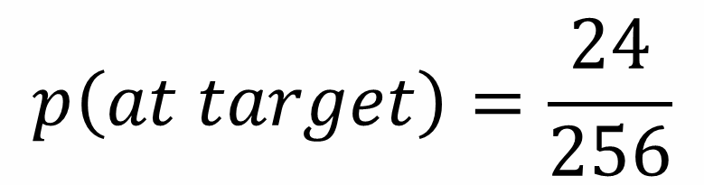
Problem 6
Num moves: 4
End Point
Start Point
$$p\left(at target\right)=\frac{24}{256}$$
?
?

Slide 10
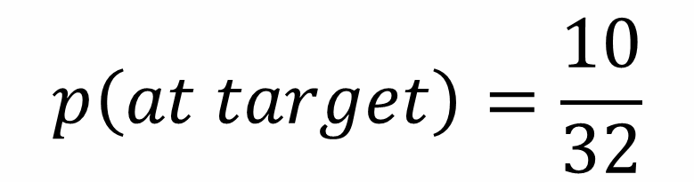
Problem 7
Num moves: 5
Start Point
End Point
$$p\left(at target\right)=\frac{10}{32}$$
?
?

Slide 12

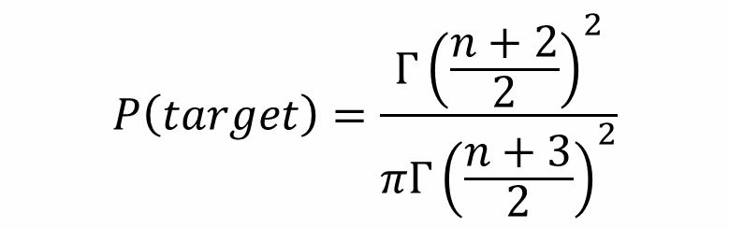
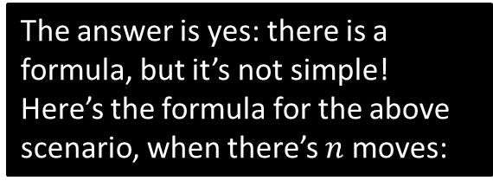
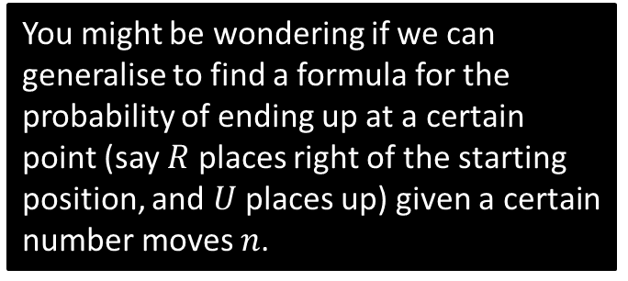
For your curiosity…
You might be wondering if we can generalise to find a formula for the probability of ending up at a certain point (say $R$ places right of the starting position, and $U$ places up) given a certain number moves $n$.
Num moves: $n$
End Point
Start Point
The ‘gamma function’ is like the factorial function, but works for decimals and negative numbers.
$$P\left(target\right)=\frac{Γ{\left(\frac{n+2}{2}\right)}^{2}}{πΓ{\left(\frac{n+3}{2}\right)}^{2}}$$
The answer is yes: there is a formula, but it’s not simple!
Here’s the formula for the above scenario, when there’s $n$ moves:

